Slide 1
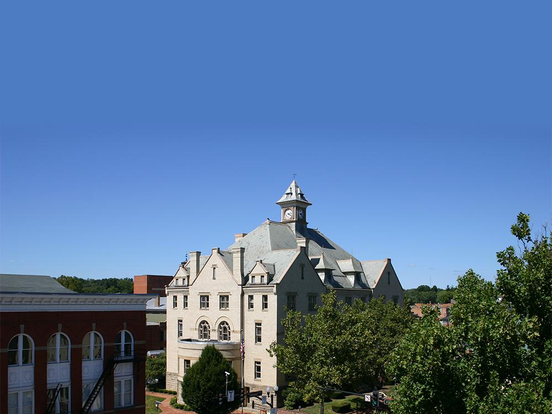
Proposed Enterprise Zone Boundary & Incentive Amendments

Slide 2
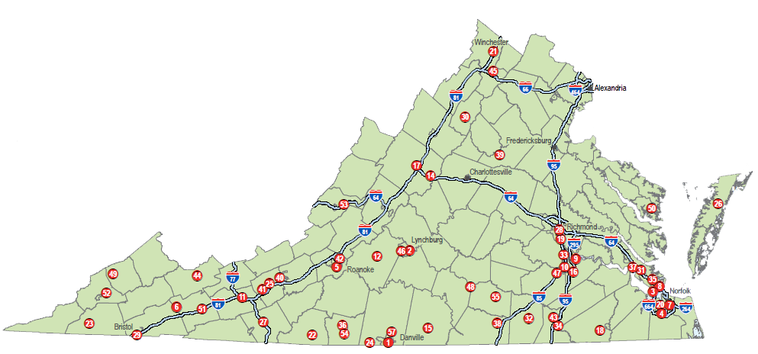
Program Overview
Partnership between the Department of Housing and Community Development and localities within the Commonwealth to increase job creation, encourage capital investment and promote business expansion and retention.

Slide 3
Winchester’s VEZ History
In 2013, the Commonwealth of Virginia designated the City of Winchester as an Enterprise Zone Community.
Fifteen local incentives, including loans, grants, and tax exemptions, are available to eligible real estate investors and business owners within the zone.
EDA staff propose an amendment to the zone boundaries and incentives.

Slide 4
Amendment Application Process
DHCD preliminarily approved the draft boundary amendment on
July 5, 2023
The EDA Board approved the draft boundary amendment on July 18, 2023
Planning and Economic Development Committee (PED) approved the draft boundary amendment on August 31, 2023
A public input session was offered from September 1, 2023, through September 15, 2023, using Open Town Hall; letters were mailed to property owners on September 1, 2023
EDA staff to present amendment to Winchester Common Council on September 26, 2023 and will be subject to their approval
If approved by Common Council, EDA staff will submit the application to DHCD for final approval of the boundary amendment by November 1, 2023

Slide 5
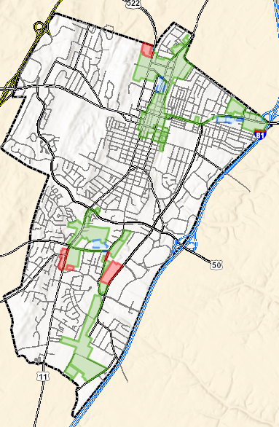
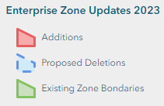
Boundary Amendments
Program guidelines allow
maximum zone coverage of 640 acres
Current zone boundaries
encompass 594.3 acres
With the proposed deletions
and additions, total zone
acreage would increase to
608.6 acres
Interactive Map: https://winchestercity.maps.arcgis.com/apps/dashboards/5fc3855dc3344a2ebee57d240d38feca

Slide 6
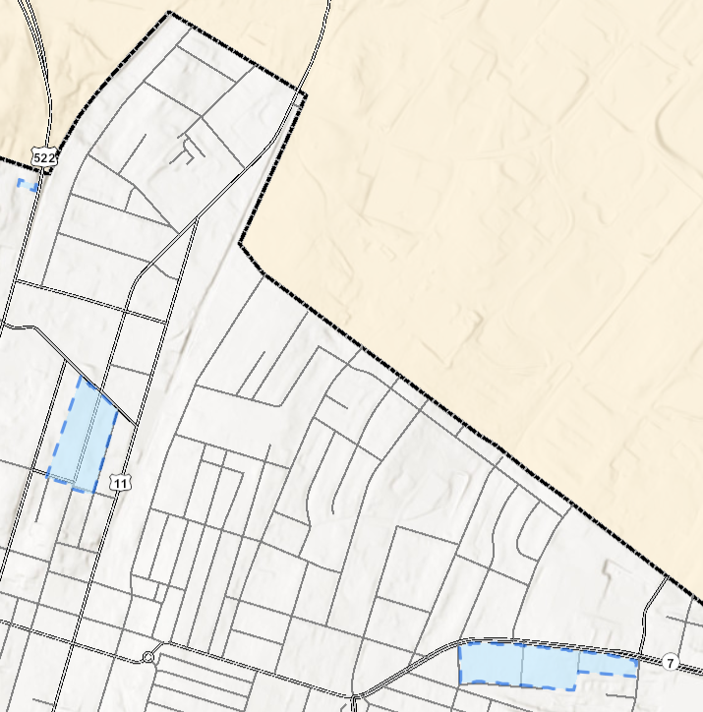
Northern Zone Proposed Deletions
703 Berryville Avenue; 707 Berryville Avenue; 711 Berryville Avenue; 715 Berryville Avenue; 719 Berryville Avenue; 723 Berryville Avenue; 727 Berryville Avenue; 731 Berryville Avenue; 735 Berryville Avenue; 739 Berryville Avenue; 743 Berryville Avenue; 747 Berryville Avenue; 803 Berryville Avenue; 807 Berryville Avenue; 811 Berryville Avenue; 815 Berryville Avenue; 819 Berryville Avenue; 823 Berryville Avenue; 827 Berryville Avenue; 831 Berryville Avenue; 835 Berryville Avenue; 839 Berryville Avenue; 903 Berryville Avenue; 907; Berryville Avenue; 911 Berryville Avenue; 915 Berryville Avenue; 919 Berryville Avenue; 923 Berryville Avenue; 927 Berryville Avenue; 929 Berryville Avenue; 943 Berryville Avenue; 428 Chestnut Street; 883 Fairmont Avenue; 704 Frederick Avenue; 708 Frederick Avenue; 712 Frederick Avenue; 716 Frederick Avenue; 720 Frederick Avenue; 724 Frederick Avenue; 732 Frederick Avenue; 736 Frederick Avenue; 740 Frederick Avenue; 744 Frederick Avenue; 808 Frederick Avenue; 812 Frederick Avenue; 816 Frederick Avenue; 820 Frederick Avenue; 824 Frederick Avenue; 828 Frederick Avenue; 832 Frederick Avenue; 836 Frederick Avenue; 501 N. Loudoun Street; 502 N. Loudoun Street; 504 N. Loudoun Street; 505 N. Loudoun Street; 506 N. Loudoun Street; 508 N. Loudoun Street; 510 N. Loudoun Street; 512 N. Loudoun Street; 513 N. Loudoun Street; 514 N. Loudoun Street; 515 N. Loudoun Street; 518 N. Loudoun Street; 520 N. Loudoun Street; 521 N. Loudoun Street; 522 N. Loudoun Street; 523 N. Loudoun Street; 526 N. Loudoun Street; 527 N. Loudoun Street; 528 N. Loudoun Street; 529 N. Loudoun Street; 531 N. Loudoun Street; 532 N. Loudoun Street; 536 N. Loudoun Street; 539 N. Loudoun Street; 540 N. Loudoun Street; 541 N. Loudoun Street; 545 N. Loudoun Street; 548 N. Loudoun Street; 550 N. Loudoun Street; 551 N. Loudoun Street; 552 N. Loudoun Street; 553 N. Loudoun Street; 555 N. Loudoun Street; 402 Maple Street; 406 Maple Street; 4 E. North Avenue; 6 E. North Avenue; 8 E. North Avenue; 16 W. North Avenue; 20 W. North Avenue; 513 Spruce Street

Slide 7
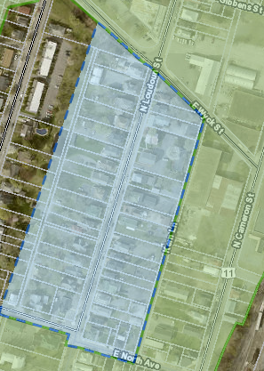
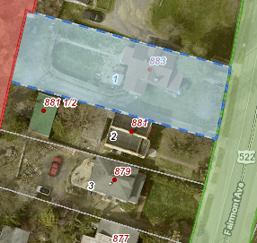
Northern Zone Proposed Deletions Cont’d.
Zone: MR 12.79 Acres
Total proposed deletion: 23.42 acres
Properties proposed for deletion are outlined in blue
Zone: HR-1 10.37 Acres
Zone: M-1 .26 Acres

Slide 8
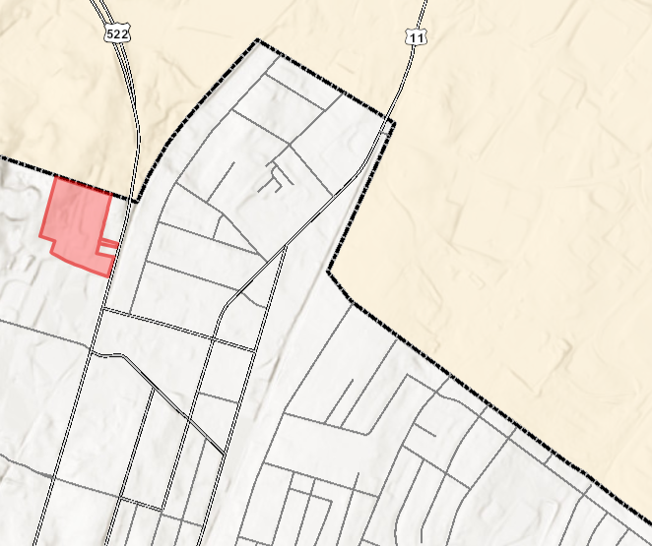
Northern Zone Proposed Additions
801 Fairmont Avenue; 871 Fairmont Avenue

Slide 9
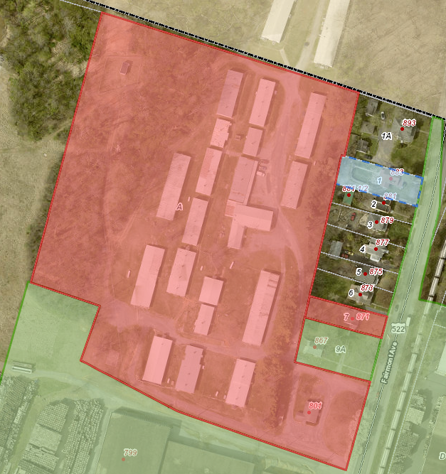
Northern Zone Additions Cont’d.
Total proposed addition: 10.43 acres
Properties proposed for addition are
outlined in red
Zone: M-1

Slide 10
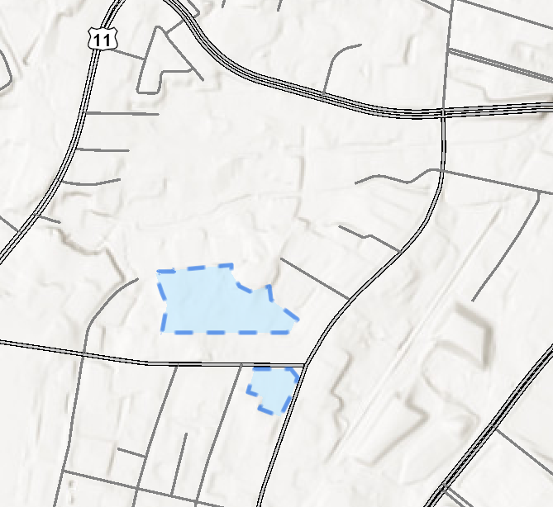
Southern Zone Proposed Deletions
5 Weems Lane; 140 Weems Lane; 144 Weems Lane

Slide 11
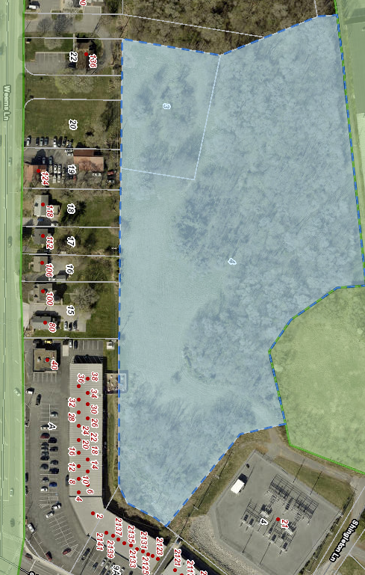
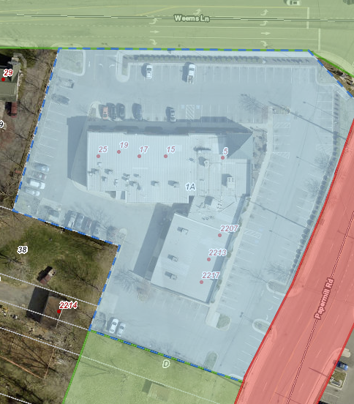
Southern Zone Deletions Cont’d.
Total proposed deletion: 10.36 acres
Properties proposed for deletion are outlined in blue
Zone: CM-1 8.44 Acres
Zone: B-2 1.92 Acres

Slide 12
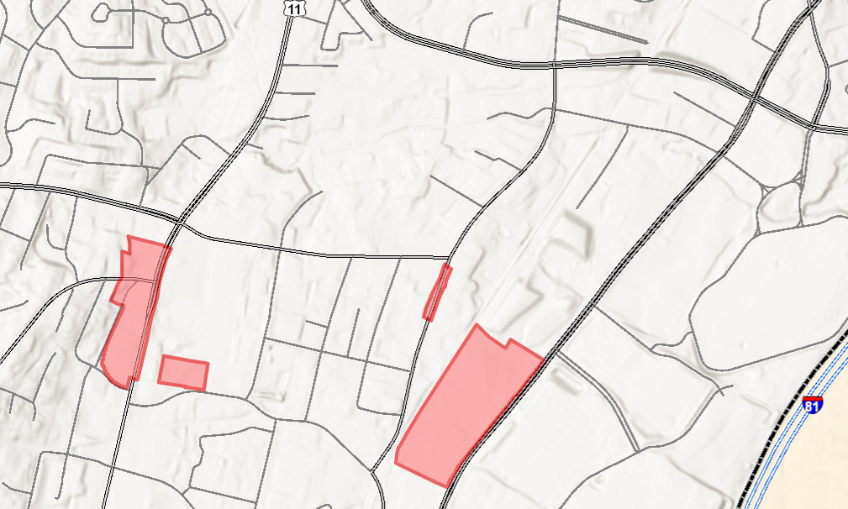
Southern Zone Proposed Additions
330 Hope Drive; 2410 Papermill Road; 2416 Papermill Road; 2223 Valley Avenue; 2227 Valley Avenue; 2229 Valley Avenue; 2251 Valley Avenue; 2291 Valley Avenue; 2311 Valley Avenue; 2405 Valley Avenue; 2409 Valley Avenue; 2417 Valley Avenue; 2425 Valley Avenue; 2431 Valley Avenue; 2433 Valley Avenue; 2441 Valley Avenue

Slide 13
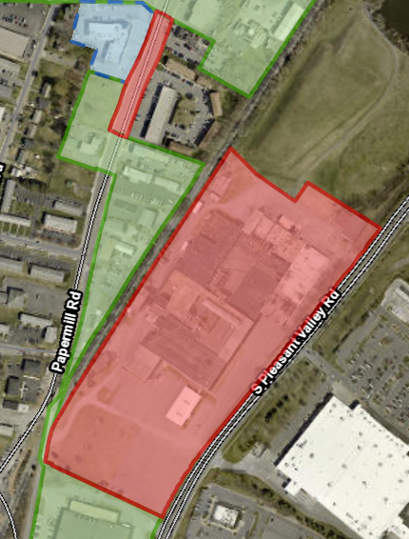
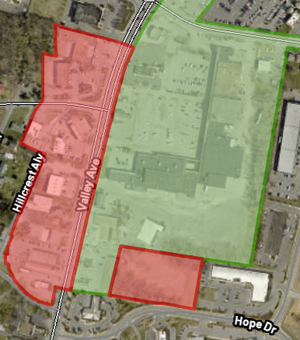
Southern Zone Additions Cont’d.
Total proposed addition: 37.71 acres
Properties proposed for addition are
outlined in red
Zone: B-2 14.14 Acres
Zone: B-2 23.57 Acres

Slide 14
Incentive Amendments
Program Goals:
Spur Job Creation
Encourage Capital Investment
Promote Business Expansion & Retention
Stimulate Real Estate Development
Assist Entrepreneurs & Small Business Owners

Slide 15
Incentive Amendments Ordinance
To implement the approved incentive amendments, an ordinance to amend Ch. 8 Article 1 Section 8-15, Article 2 Section 8 26-29, and Ch. 27, Article 2, Division 4(A) Section 27-29 of the Winchester City Code is required.

Slide 16
Loan Amendments Suggestions
Name | Before | New Suggestions
Commercial Façade Loan | Exclusive to EZ 2.5% Interest Rate Loan repayment can be deferred for up to two/three years. Option of Deferment Partial Disbursements Budgeted $100,000 a year | City Wide 3.5% Interest Rate 2.5% Interest Rate for a business located in EZ Eliminate the Deferred, Deferment and Partial Disbursement option. Budgeted $50,000 a year
Enterprise Zone Micro-Loan | Exclusive to EZ $1,000 to $10,000 7% 24 months; except equipment loans, 36-60 months Budgeted $15,000 a year | City Wide Increase to $1,000 to $15,000 Prime rate -1 Prime Rate for Business Located in the EZ 36 months Budgeted $25,000 a year Change name to “Micro Loan”
Real Estate Development Revolving Loan Fund | City Wide $250,000 or 45% project. Cover soft costs (property development, including legal, architectural, engineering, survey, and other related cost) 50 basis points above the interest rate of the US treasury Budgeted $400,000 a year | Citywide $250,000 or 25% project cost $250,000 or 35% of project cost for a business located in EZ Remove coverage of soft costs. Add Requirement private financing first and/or SBDC and equity. Rate: mirror bank terms Budgeted $550,000 a year
Business Growth Revolving Loan | City Wide $100,000 or 45% project. 5 years 50 basis points above the interest rate of the US treasury Budgeted $100,000 a year | Citywide $100,000 or 25% project cost $100,000 or 35% of project cost for a business located in EZ Rate: mirror bank terms Add Requirement private financing first and/or SBDC and equity. Budgeted $200,000 a year.

Slide 17
Grants Amendments Suggestions
Name | Before | New Suggestions
Exterior Improvement Grant | Exclusive to EZ 50% of the improved cost up to $10,000 façade improvements Budgeted $50,000 a year | City Wide 50% of the improved cost up to $15,000 façade improvements 50% of the improved cost up to $20,000 façade improvements Budgeted $60,000 a year
NEW Chamber of Commerce membership fee waivers | New incentive proposed. | City Wide Up to $1,500 can be granted in a year. Grant is meant for small businesses within the city limits with fewer than 50 employees. 2 TVRC memberships will be granted to new businesses, or 1 TVRC membership will be granted to an existing business. 1 Community Leadership Program Class (CLP) Priority will be given to businesses located in the EZ. Budgeted $2,000 a year.
Commercial/ Industrial/ Mixed-Use Property Rehabilitation Grant | Exclusive EZ Incentive: $10,000 for a new assessed value of $250,000 - $499,000 $15,000 per grant for a new assessed value of $500,00 or more. A one-time cash grant for commercial or mixed-use property within the EZ that has a substantially improved assessed value of at least 40% Budgeted $50,000 a year | Budgeted $25,000 a year.

Slide 18
Tax Abatements Amendments Suggestions
Name | Before | New Suggestions
Business Development Grant | Exclusive EZ The property must be a “substantial rehabilitation,” equaling 75% of the property’s assessed value. Brownfield Building The grant size will be based on the following criteria: 100% of all business taxes for rehabilitating vacant structures over 40,000 square feet. 50% of all business taxes for rehabilitating vacant structures between 20,000 and 40,000 square feet. 25% of all business taxes for rehabilitating vacant structures between 5,000 and 20,000 square feet. Budgeted $100,000 a year | Exclusive EZ Remove the brownfield requirement. The city council must approve. Must add incentive to the site plan. The grant size will be based on the following criteria: 65% of all business taxes for rehabilitating vacant structures larger than 40,000 square feet. 50% of all business taxes for rehabilitating vacant structures between 20,000 and 40,000 square feet. 25% of all business taxes for rehabilitating vacant structures between 5,000 and 20,000 square feet. Budget: To be determined based on the rehabilitating taxes.
Major Mixed Use | Exclusive EZ 20 Years 35%-65% of net new taxes paid to the city. Budget is to be determined based on payments on outstanding bonds | Exclusive EZ 10 years The city council must approve. Must add incentive into the site plan. The grant size will be based on the following criteria: 25% commercial – 35% Tax rebate 30% commercial – 40% Tax rebate 35% commercial – 45% Tax rebate 40% commercial – 50% Tax rebate 45% commercial – 55% Tax rebate 50% commercial – 60% Tax rebate 55% commercial – 65% Tax rebate Budget: To be determined based on the commercial %.

Slide 19
Deletion Suggestions
Name |  | Notes
Entrepreneurship Incentive | A grant Equal to 50% of the cost of website design and construction, up to $1,000, paid to a Winchester City-based design provider: 50% of the cost of website hosting or high-speed internet access, up to $500; and a 200-basis point interest rate reduction on a Winchester EZ Micro-loan. Budgeted $6,000 a year | It has not been utilized
New or Expanding Technology-driven Business Grant | Any Technology-driven Business defined as a firm engaged in advanced manufacturing, classified in the bio-information or bio-medical industry, that is a knowledge-producing federal government contractor, or that has been determined to be technology-driven by the EDA. Grants shall be made in arrears of the payment of qualifying taxes and shall be equal to fifty percent (50%) of the Net Increase in such taxes over a five-year period. Maximum of $500,000 over a five-year period. Budgeted $100,000 a year | It has not been utilized
Professional Job Creation | Grants payments will be made after the job has been in existence for at least twelve months. The incentive will equal a one-time payment of $1,500 per position if the firm creates between one and ten full-time eligible jobs over their base employment number. The grant will increase to $2,000 per position if the firm creates an additional one to five jobs. Budgeted $50,000 a year | It has not been utilized. States offer a similar grant for EZ “Job Creation Grant)

Slide 20
Deletion Suggestions Cont’d
Name |  | Notes
Major Economic Development | Offered to qualify recipients equal to the present value of one hundred percent of net new taxes paid by the recipient’s business over three years to the city. The grant may be paid either as an upfront incentive secured by a forgivable deed of trust at the discretion of the Economic Development Authority of the City of Winchester, or the grant may be paid annually in arrears. Must make a capital investment of at least $2.5 million and create at least 25 new jobs that pay for at least the City’s median income. The company must remain in Winchester for at least five years after receiving the last grant. Budgeted $250,000 a year | Combined into Major Mixed Use
Substantially Rehabilitated Residential/Commercial | Property owners who increase the assessed value of their property by at least 40%. Qualifying square footage includes the original structure and up to 200% of the original square footage. Will receive a tax exemption for a period of 10 years over the real estate assessment on improvement prior to the rehabilitation. Or receive a one-time payment cash grant based on the post-rehabilitated assessed value of the property. Budgeted $50,000 a year | City Winchester Provides a similar incentive. Substantially Rehabilitated Historic Property Tax Exemption. Combined with Business Development Grant
Exemption from Land Development Fees | A non-residential improvement project must have a minimum new construction cost of $500,000 or, if completing a renovation, a cost equal to at least 60% of the pre-renovation assessed value of improvements. A residential project must result in an assessment of improvements 140% or higher than the average residential improvement within the North Loudoun Street District. Financial Value of Incentive: Non-Residential: Cost of a building permit, zoning application, or subdivision plat fees. Residential: Cost of a building permit, zoning application, or subdivision plat fees. Budgeted None | It has not been utilized

Slide 21
Additional Notes
Change all EDA grants city-wide but keep tax abatements as EZ.
Multiple grants must be requested simultaneously.
Add or Update Guidelines, policies, and procedures for all incentives.

Slide 22
Questions or Comments?

